Slide 1

Customer Retention Case Study
Customer retention refers to the ability of a company or product to retain its customers over some specified period. High customer retention means customers of the product or business tend to return to, continue to buy or in some other way not defect to another product or business, or to non-use entirely.
Prepared by Anubhav Saxena

Slide 2

Agenda:
Introduction
Problem Statement
Objective
Exploratory Data Analysis (EDA)
Visualization
Inference
Future Work

Slide 3
Introduction
What is Customer Retention and do we really need it?
“Customer retention refers to a business' capacity to convert consumers into repeat purchasers and keep them from transferring to a rival.”
To put it another way, client retention entails "maintaining current consumers“
This can only happen if the firm and the client have a good relationship.

Slide 4
What are the benefits of Customer Retention ?
Customers who have been with a firm for a long time are more likely to purchase additional services from the same company.
Customers that have been with you for a long time are believed to be less price/cost sensitive.
Selling to an established customer has a 60-70 percent chance of success.
There's a 5-20% chance of selling to a new prospect.
A decrease in the number of people migrating.
Getting a new client is more expensive than keeping an existing one.

Slide 5
Tips for Succeeding at Customer Retention
Find out what your consumers desire and why they remain or go.
Collect and promote client feedback in a proactive manner.
Analyze client feedback to acquire useful insights and make sure it reaches the proper people.
Take action and track your progress.
Measure and track your consumers' loyalty and involvement on a regular basis.
Continue to inquire, listen, analyze, and improve.

Slide 6
Motivation for the Problem Undertaken
Consumer retention entails more than simply providing what the customer expects.
Exceeding client expectations may be necessary to create brand loyalists.
Customer loyalty is achieved by putting "customer value, rather than maximization of profits and shareholder value, at the core of corporate strategy.“
In a competitive climate, delivering a consistently high level of customer service is frequently the crucial differentiator.
Furthermore, retention is a crucial goal in the new world of Customer Success.

Slide 7
Problem Statement
Consumer happiness has emerged as one of the most significant criteria in ensuring an online store's success; it has been identified as a primary stimulator of buy or repurchase intentions, as well as customer loyalty.
To present the models for customer activation and retention, a thorough assessment of the literature, theories, and models was conducted.
Service quality, system quality, information quality, trust, and net benefit were recognised as five important variables that contributed to the success of an e-commerce shop.
The study also looked at the elements that impact the likelihood of repeat purchases by internet clients.
To favorably influence repeat purchase intention (loyalty), a mix of utilitarian and hedonistic values is required.
The information was gathered from Indian internet shoppers. The findings reveal the e-retail success characteristics that are crucial for client happiness.

Slide 8
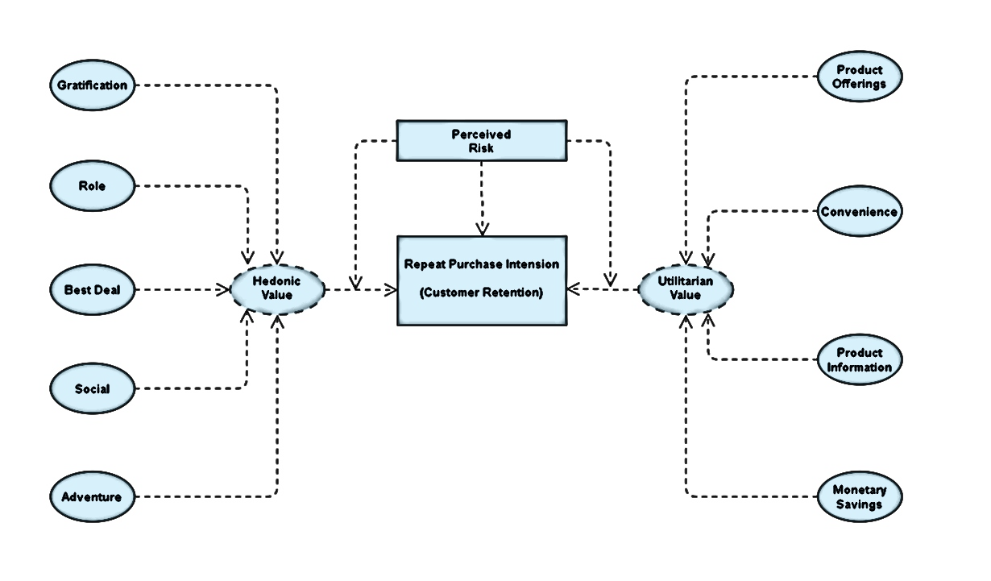
The problem statement can be represented in the form of below use case diagram as well.

Slide 9
Objective
The goal is to employ analytical abilities to come up with discoveries and conclusions that will enable an E-Retail firm forecast client retention utilizing data on customers collected over time.
I was given the responsibility of finding which elements were most significant in the loss of a valuable client using the model, and then devising a strategy for how the organization might use this knowledge to boost customer retention.

Slide 10
Exploratory Data Analysis (EDA)
Requirements | Tools Used
Hardware | RAM: 8 GB Processor : Intel(R) Core(TM) i3-7100U CPU @ 2.40GHz 2.40 GHz
Software | Programming language : Python Distribution : Anaconda Navigator Browser based language shell : Jupyter Notebook
Libraries/Packages | Pandas NumPy matplotlib seaborn scikit-learn

Slide 11
First, I loaded the complete dataset into our Jupyter Notebook and renamed the columns after importing the appropriate libraries.
Then I looked at the layout of our data and saw that we had 269 rows and 71 distinct columns.
In our dataset, there are no null or missing values.
In our dataset, there are 22% duplicate records; nevertheless, rather than eliminating them, I elected to keep them.
By looking at the data types, I discovered that all of the columns are of the 'object' data type, with the exception of the Pin Code column, which is of the 'integer' data type.
Shape : 269 rows and 71 columns.
No null values present.
22% duplicate fields/records found.
Datatypes of all the columns are objects except for the “Pin Code" column which has integers.

Slide 12





Dataset Description
The information was gathered from Indian internet shoppers. Our data collection includes consumer reviews and comments from Amazon, Flipkart, Snapdeal, Myntra, and Paytm, five of India's most popular online retailers.
With the purpose to suggest, a questionnaire is created based on brand strength, brand empathy or dedication, total consumer happiness, and perceived value for money.
The findings reveal the essential e-retail success elements for customer happiness and retention.
The top 5 Indian Online Retailers:

Slide 13
Visualization
What is the definition of data visualization? A graphical depiction of information and data is referred to as data visualization.
What are the advantages of good data visualization? Data visualization is another visual art approach that piques our interest and retains our attention on the message collected by the eyes.
There are several types of data visualization analysis. Univariate Analysis: We will use a single characteristic to assess practically
all of its attributes in a univariate analysis. Bivariate Analysis: Bivariate analysis is when we compare data between two attributes that are precisely the same. Multivariate Analysis: We shall compare more than two variables in the
multivariate analysis.

Slide 14
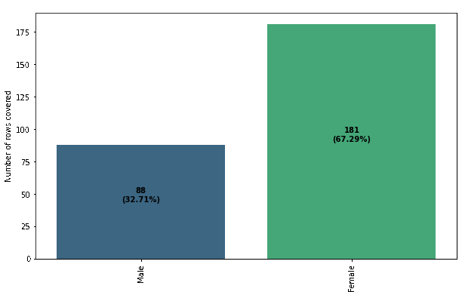
Univariate Analysis:
I was able to determine the total number of rows covered by each unique category value contained in all columns of our dataset using count plots.
I made sure that the proportion of data coverage is presented with the overall row number.

Slide 15
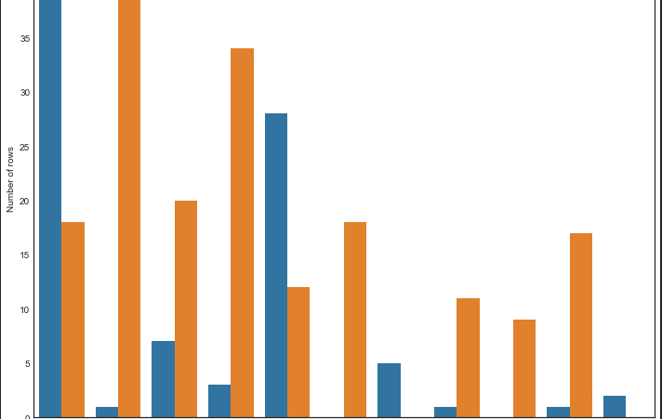
Bivariate Analysis:
I was able to provide analysis details comparing two columns of the dataset where the hue remained constant while the other one changed in a loop using the count plot and the hue parameter.
The "Gender" column is the color utilized in this plot, and the caption is displayed appropriately.

Slide 16
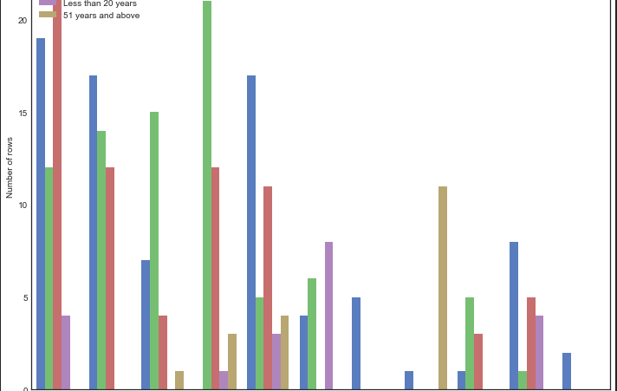
Bivariate Analysis:
I was able to obtain analytical information by comparing two columns of the dataset where the hue remained constant while the other one changed in a loop, using the count plot and the hue parameter.
The "Age" column is the color utilized in this plot, and the legend is displayed appropriately.

Slide 17
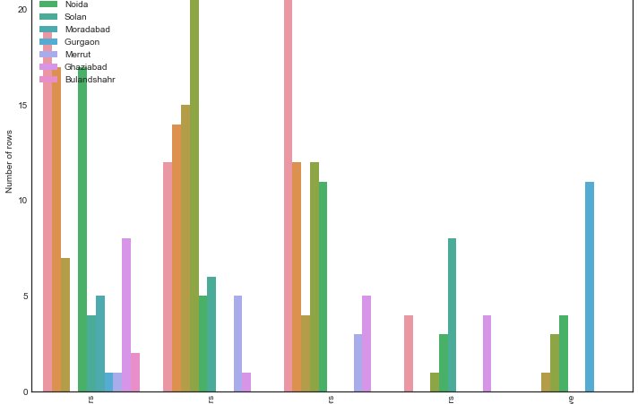
Bivariate Analysis:
I was able to provide analysis details comparing two columns of the dataset where the hue remained constant while the other one changed in a loop using the count plot and the hue parameter.
The "City" column is the hue utilized in this plot, and the legend is displayed appropriately.

Slide 18
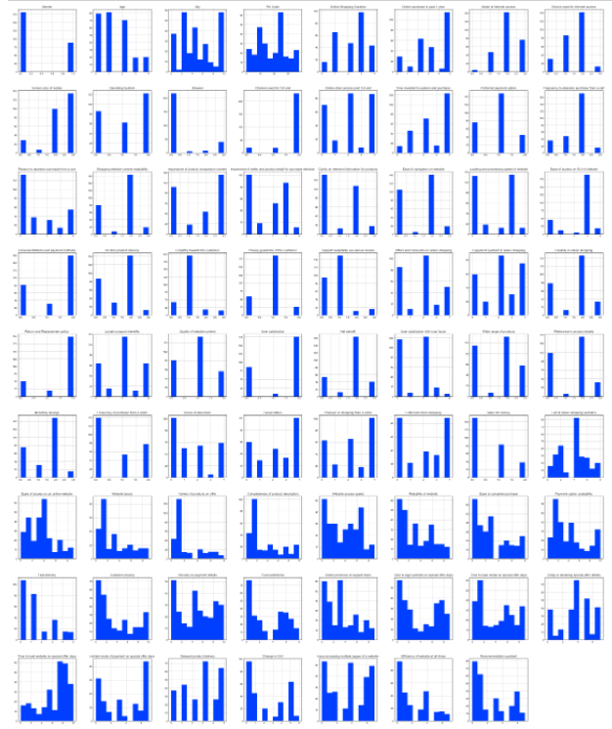
Multivariate Analysis:
After encoding all of the columns in our dataset, I utilized the histogram.
The histogram would not have created a diagrammatic representation of object datatype columns since it only understands numeric values.
The information was shown as histograms when the encoding was completed.

Slide 19
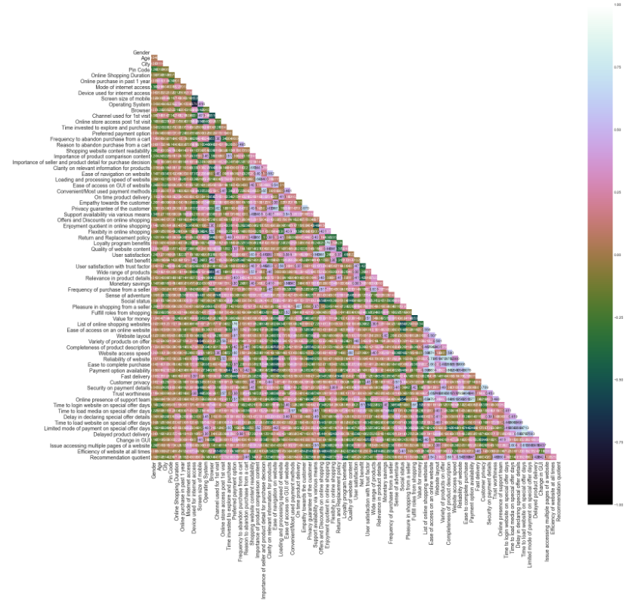
Multivariate Analysis:
To observe the correlation information between the columns, I utilized the heatmap on the encoded dataset.
Even though the picture was too small to see on the Jupyter Notebook, I was able to deduce from the color choices that there is no multi collinearity between the columns.

Slide 20
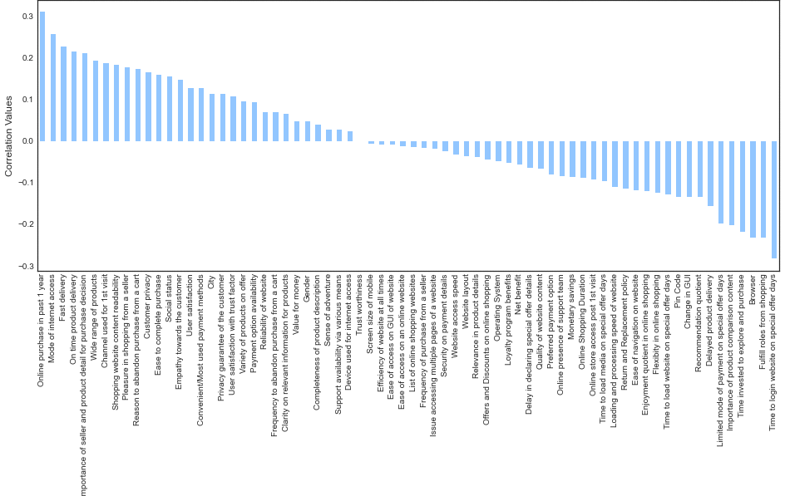
Correlation between the columns:
I created separate bar plots using the correlation technique to check the positive and negative correlation details in our dataset.
A perfect positive correlation is shown by a correlation of +1, which means that both variables move in the same direction.
A negative correlation of -1 implies a complete negative correlation, which means that when one measure rises, the other falls.

Slide 21
Inference
The first 47 aspects, based on general observations, give insights into how e-retail is beneficial and increasing based on consumer feedback. The data revealed which CITY, PIN CODE, AGE, and other variables were utilized most frequently on the web platform. It also revealed that some criteria are given less weight in contributing to the success of an e-commerce site, allowing us to eliminate such aspects while keeping all the vital ones. We might also improve on some of the elements that impact the likelihood of repeat purchases by internet clients.
Apart from the first 47 elements, the remaining features demonstrated which web platform was utilized more frequently depending on success factors. According to the customer activation and retention case study, Amazon is the most dependable and has met all of the consumer needs. Following Amazon, research indicated that Flipkart was utilized more for online shopping.
According to a case study of Indian e-commerce clients, Amazon and Flipkart are the most frequently utilized for online shopping and are the most frequently suggested by friends. So, based on the research considerations, Amazon and Flipkart are e-commerce platforms that combine utilitarian and hedonistic values to favorably influence recurrent purchase intent (loyalty).

Slide 22

1. Amazon.com
To be improved:
1. During promotions, attempt to provide clients with a stress-free shopping experience.
2. Provide clients with more payment alternatives.
3. Give the pricing as soon as possible during the offer.
4. Shorten the time it takes for things to arrive.
Positive feedback summary:
Easy to use and also an excellent purchasing website.
2. Products are delivered quickly.
3. Availability of comprehensive product information.
4. The availability of multi-channel online help.
5. Trustworthy website or app, as well as perceived trustworthiness.
Online Store Company:

Slide 23

2. Flipkart.com
To be better:
During promotions, attempt to provide clients with a stress-free shopping experience.
2. Provide clients with more payment alternatives.
3. Give the pricing as soon as possible during the offer.
4. Shorten the time it takes for things to arrive.
The main difference between Flipkart and Amazon is that their feedback is almost equal, but with different percentages.
Positive feedback summary:
Easy to use and also an excellent purchasing website.
2. Products are delivered quickly.
3. Availability of comprehensive product information.
4. The availability of multi-channel online help.
Online Store Company:

Slide 24
3. Myntra.com
To be improved:
During promotions, try to give a disturbance free shopping experience to customers.
2. Try to give the price early during promotions.
3. Reduce the delivery time of the products during promotions.
Positive feedback summary:
1. Convenient to use and also a good website.
2. Availability of several payment options.
3. Faster products delivery.
4. Complete information of products available.
5. Reliable website or app, perceived trustworthiness.
6. Wild variety of product to offer
Online Store Company:

Slide 25

4. Paytm.com
To be improved:
1. Reduce the delivery time of the products during promotions.
2. Try to give the price early during promotion.
3. During promotions, try to give a disturbance free shopping experience to customers.
4. Late declaration of price and discounts.
5. Frequent disturbance is occurring while moving from one page to another.
Positive feedback summary:
1. Convenient to use and a good website.
2. Quickness to complete a purchase.
3. About 64% of the customers feel that either web or app is reliable.
4. Around 20% of the customers believe that Paytm has a wild variety of products on offer.
Online Store Company:

Slide 26
5. Snapdeal.com
To be improved:
1. Reduce the delivery time of the products during promotions.
2. Try to give the price early during promotion.
3. During promotions, try to give a disturbance free shopping
experience to customers.
4. Late declaration of price and discounts.
5. No one has expressed to recommend Snapdeal to a contact as it has the most negative feedbacks among all other websites.
Positive feedback summary:
1. Convenient to use.
2. 54% of the customers are happy about the availability of financial information security.
Online Store Company:

Slide 27
Future Work
I'll have to do some preparation on the data, such as utilizing scaling techniques.
I'm not going to bother about reducing outliers or skewness because the dataset contains largely categorical data.
Unsupervised machine learning models must be built.
Will need to double-check the specifics of the clustering or association method that may be utilized on the dataset.
K-means clustering, k-nearest neighbors for unsupervised machine learning, hierarchal clustering, apriorism algorithm, and neural networks are some of the methods I plan to work on.

Slide 28


